Slide 1
Computer Networks
By
Lt Col Ishtiaq Kiani
(10 Sep 12 to 12 Jan 13)

Slide 2
PART 2
Physical Layer

Slide 3
Chapter 6 Bandwidth Utilization : Multiplexing and Spreading
Multiplexing
Spread Spectrum
Sometimes we need to combine several low-bandwidth channels to make use of one channel with a larger bandwidth. Sometimes we need to expand the bandwidth of a channel to achieve goals such as privacy and antijamming.
Bandwidth utilization is the wise use of available bandwidth to achieve specific goals.
Efficiency can be achieved by multiplexing;
privacy and antijamming can be achieved by spreading.

Slide 4
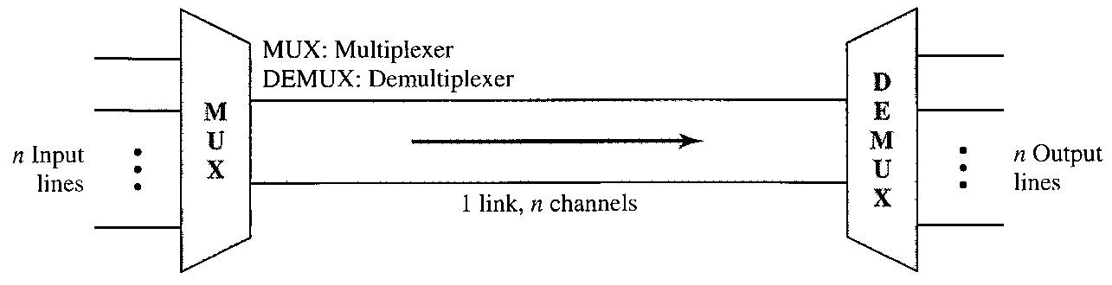
Multiplexing
Multiplexing is the set of techniques that allows the simultaneous transmission of multiple signals across a single data link
In a multiplexed system, n lines share the bandwidth of one link
The lines on the left direct their transmission streams to a multiplexer which combines them into a single stream. At the receiving end, that stream is fed to de-multiplexer, which separates the stream back into its component transmissions and direct them to their corresponding lines.
Word link refers to the physical path
The word channel refers to the portion of a link that carries a transmission between a given pair of lines

Slide 5
Multiplexing

Slide 6
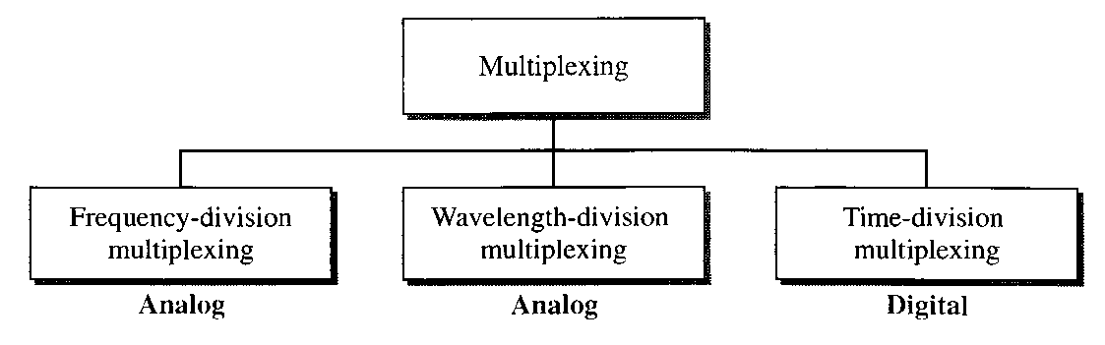
Multiplexing

Slide 7
Multiplexing
Frequency Division Multiplexing

Slide 8
Multiplexing
Frequency Division Multiplexing
Time Domain

Slide 9
Multiplexing
Frequency Division Multiplexing
Frequency Domain

Slide 10
Multiplexing
Frequency Division Multiplexing
Time Domain

Slide 11
Multiplexing
Frequency Division Multiplexing
Frequency Domain

Slide 12
Multiplexing
Frequency Division Multiplexing
Analog Hierarchy

Slide 13
Multiplexing
Frequency Division Multiplexing
Application of FDM
A very common application of FDM is AM and FM radio broadcasting
A special band from 530 to 1700 KHz is assigned to AM radio. Each station needs 10 KHz of bandwidth
Similarly, a band from 88 to 108 MHz is assigned to FM radio. Each station needs 200 KHz of bandwidth
The first generation cellular telephones also uses FDM, Each user is assigned 2 x 30 KHz channels one for sending voice and other for receiving

Slide 14
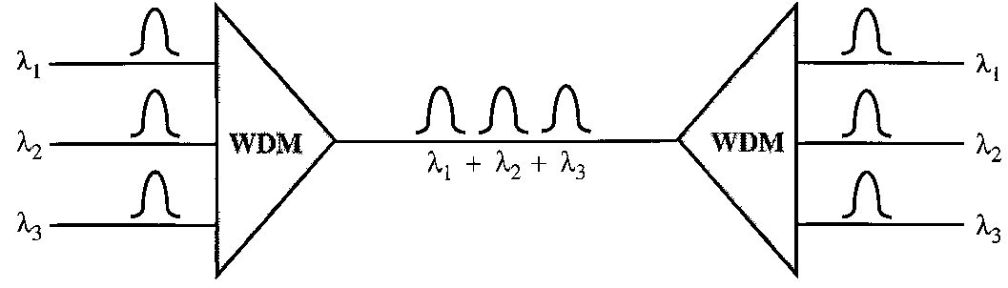
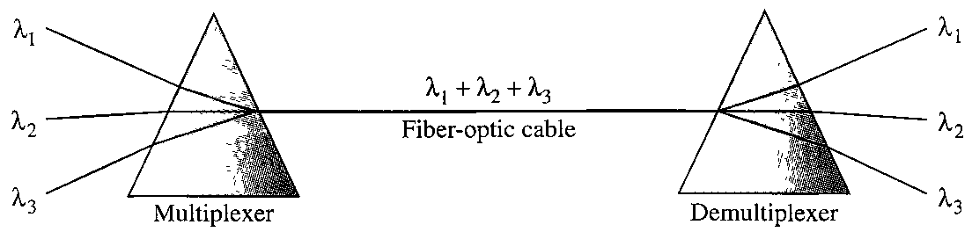
Multiplexing
Wavelength Division Multiplexing

Slide 15

Multiplexing
Time Division Multiplexing

Slide 16
Multiplexing
Time Division Multiplexing

Slide 17
Multiplexing
Time Division Multiplexing

Slide 18
Multiplexing
Time Division Multiplexing

Slide 19
Multiplexing
Frequency Division Multiplexing
Analog Hierarchy

Slide 20
Multiplexing
Time Division Multiplexing
DS Hierarchy

Slide 21
Multiplexing
Time Division Multiplexing
DS Hierarchy T1 Line

Slide 22
Multiplexing
Time Division Multiplexing
DS Hierarchy T1 Frame

Slide 23
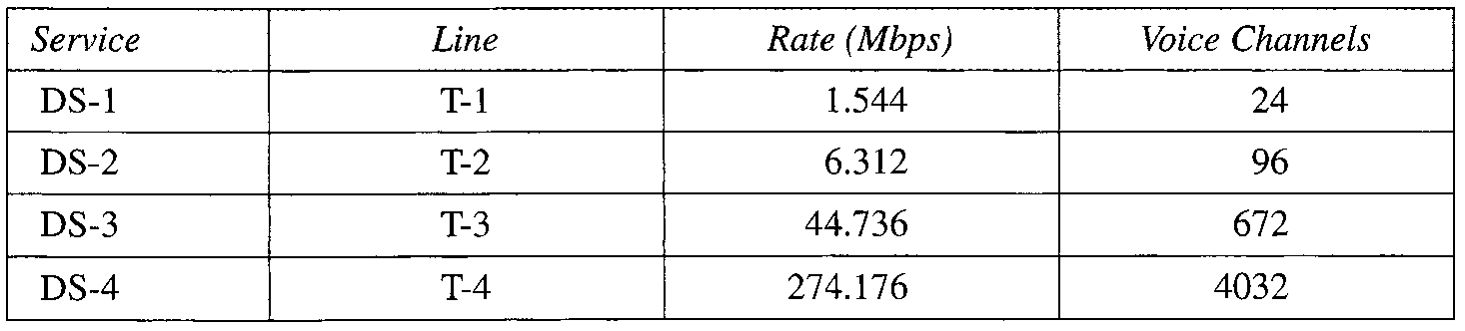
Multiplexing
Time Division Multiplexing
DS Hierarchy T Line

Slide 24
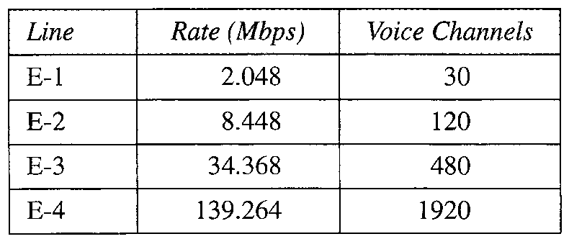
Multiplexing
Time Division Multiplexing
DS Hierarchy E Line

Slide 25
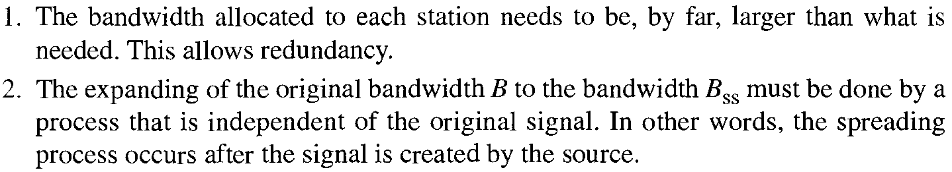
Spread Spectrum
In wireless applications, all stations use air (or a vacuum) as the medium for communication. Stations must be able to share this medium without interception by an eavesdropper and without being subject to jamming from a malicious intruder (military Operations)
To achieve these goals, spread spectrum techniques add redundancy; they spread the original spectrum needed for each station
Spread Spectrum achieve its goal through two principles

Slide 26
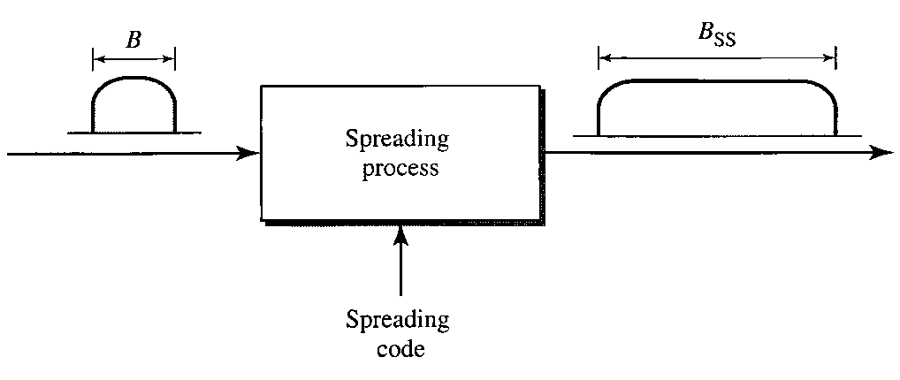
Spread Spectrum

